Slide 1

Location-Based Healthcare Facility Performance Prediction and Recommendation System
By
Jahnavi Jammula
Jithendra Uppalapati
Sai Teja Navanth Velagaturi

Slide 2


Introduction
In today's healthcare environment, choosing the right facility based on performance metrics is a critical factor for ensuring effective patient care. Our Healthcare Facility Performance Prediction System addresses this need by leveraging location-based recommendations.
Objective: The goal of this system is to help patients make informed decisions when selecting healthcare facilities by predicting and ranking facilities based on their performance in treating specific medical conditions. The system integrates advanced data processing and machine learning techniques to provide personalized, efficient, and effective healthcare access.

Slide 3

Description of Dataset
Demographic Information: Age, gender, race, etc.
Medical History: Past medical conditions such as diabetes, hypertension, cardiovascular diseases, etc.
Pre-operative Results: Lab tests like blood pressure, cholesterol levels, kidney function, etc.
Surgical Details: Type of surgery, duration, anesthesia, etc.
Postoperative Data: Vital signs, complications, recovery progress.
Target Variable: The target variable would be a binary outcome indicating in-hospital mortality (0 = survived, 1 = deceased). This would be the key variable we aim to predict using machine learning models.
Size and Types of Data: The dataset is typically large (can have tens of thousands of patient records) and includes structured data (numerical and categorical variables). It may also include some time-series data (e.g., vital signs over time), which might require special handling.

Slide 4
Description of Dataset Fields:
Facility ID: Unique identifier for each healthcare facility.
Facility Name: Name of the healthcare facility.
Address: Physical address of the facility.
City/Town: The city or town where the facility is located.
State: The state in which the healthcare facility is located (includes US states and territories).
ZIP Code: Postal code for the facility's address.
County/Parish: The county or parish where the facility is located.
Telephone Number: Contact number of the healthcare facility.
Measure ID: Identifier for the health measure or metric being reported.
Measure Name: Name of the health measure or metric being evaluated.
Compared to National: Comparison of the facility's performance to the national standard (e.g., Better, Worse, No Different).
Denominator: The number of cases or participants used in the measure.
Score: The actual score or value of the facility's performance (often includes "Not Available").
Lower Estimate: The lower bound of the confidence interval for the measure score.
Higher Estimate: The upper bound of the confidence interval for the measure score.
Footnote: Additional notes or explanations (may contain missing values).
Start Date: Start date of the data reporting period.
End Date: End date of the data reporting period.

Slide 5
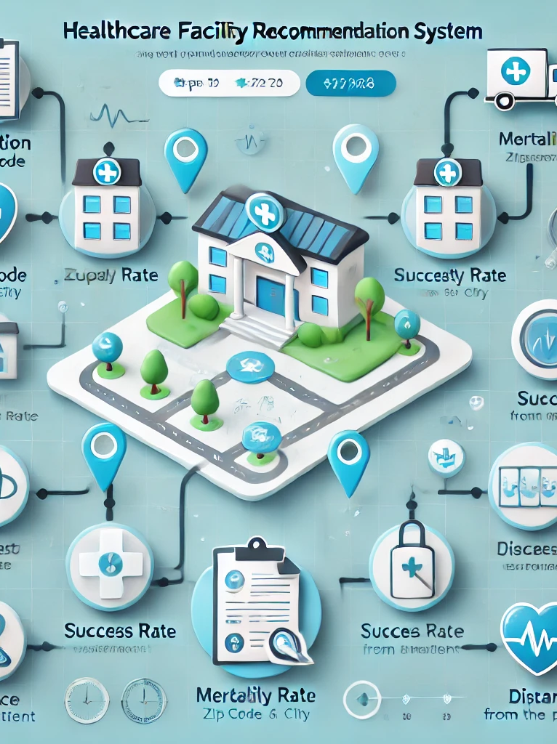
Abstract
Location-Based Recommendations: Suggests nearby facilities.
Performance Ranking: Ranks facilities based on medical outcomes.
Accessibility: Ensures recommended facilities are within reach.
Personalized Healthcare: Tailors recommendations to specific conditions.
Goal: Empower patients with informed decisions about healthcare facilities.

Slide 6
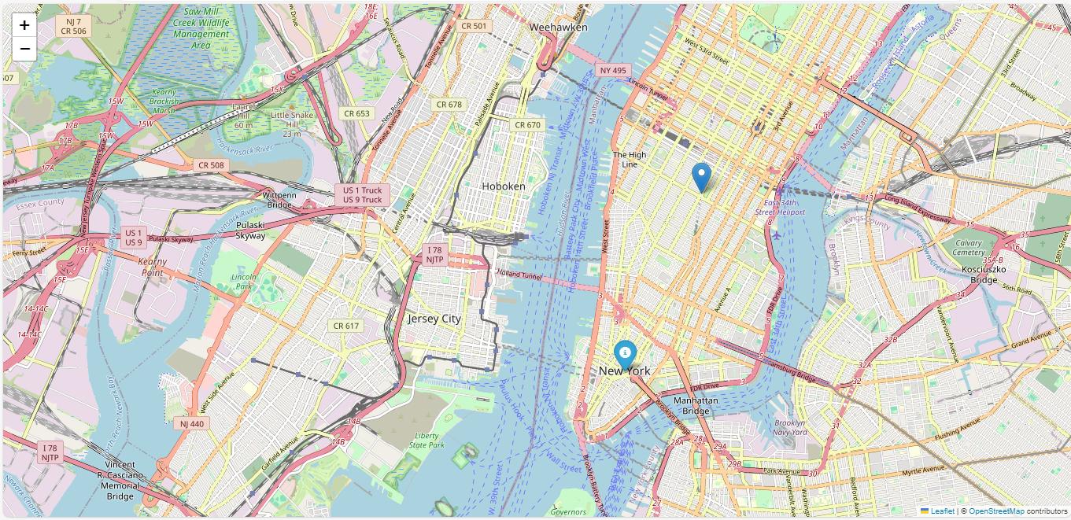

Business Need
Business Need for the Healthcare Facility Performance Prediction System
Improved Access to Quality Care: Helps patients find the best healthcare facilities based on location and medical needs.
Personalized Recommendations: Tailors suggestions to each patient's condition, ensuring optimal care.
Optimized Healthcare Resources: Assists providers in improving services and allocating resources efficiently.
Efficiency and Convenience: Saves time by presenting a ranked list of nearby hospitals, minimizing delays.
Data-Driven Decision Making: Provides insights for better planning and policy-making for stakeholders.
Increased Patient Trust: Builds confidence through transparent facility performance data.
Market Differentiation: Allows healthcare providers to stand out by showcasing their performance quality.

Slide 7


Problem Statement
Problem Statement
Develop a location-based healthcare facility recommendation system that predicts and ranks facilities based on their performance for specific medical measures.
The system should take the patient’s location as input and recommend the best-performing facilities nearby, ensuring personalized and efficient healthcare access.
Solution Approach
Input Data:
Patient location (e.g., ZIP Code, city, or coordinates).
Optional: Patient's medical condition (e.g., "pneumonia," "heart attack").
Processing Workflow:
Identify healthcare facilities within a specific radius (e.g., 10-50 miles) from the patient's location.
Filter facilities based on their Measure Name related to the medical condition (e.g., "Death rate for pneumonia patients").
Predict or retrieve performance scores for facilities using an ML model.
Rank facilities based on their predicted scores and geographic proximity.
Output:
A ranked list of facilities with the following details:
Facility Name and Address.
Performance Score.
Distance from the patient’s location.
Contact information (e.g., phone number).
Measure-specific performance (e.g., mortality or complication rates).

Slide 8







High-Level Architecture
Frontend Layer
Middleware Layer
Backend Layer
Built with React User-friendly interface Location input and map visualization
API Gateway Request validation and authentication Geocoding services
Flask API Recommendation engine Database queries and performance scoring
User
Location
Response
Response
Built with React, enabling user interactions.
Request
Request

Slide 9


Minimum Viable Product (MVP)
User-Friendly Input
Accepts patient location (ZIP Code, city, or coordinates).
Optional: Allows users to specify medical conditions (e.g., "pneumonia").
Nearby Facility Identification
Identifies healthcare facilities within a customizable radius (e.g., 10-50 miles).
Ensures personalized and location-based recommendations.
Performance-Based Ranking
Predicts or retrieves facility performance scores.
Ranks facilities based on performance and proximity.
Interactive Output
Provides a ranked list of facilities, including:
Name, address, performance score, and distance.
Displays an interactive map with marked facility locations.
Relevance to Stakeholders
Empowers patients to make informed decisions about healthcare access.
Enhances transparency and trust by showing performance metrics.
Supports healthcare providers by driving competition and improvement.

Slide 10
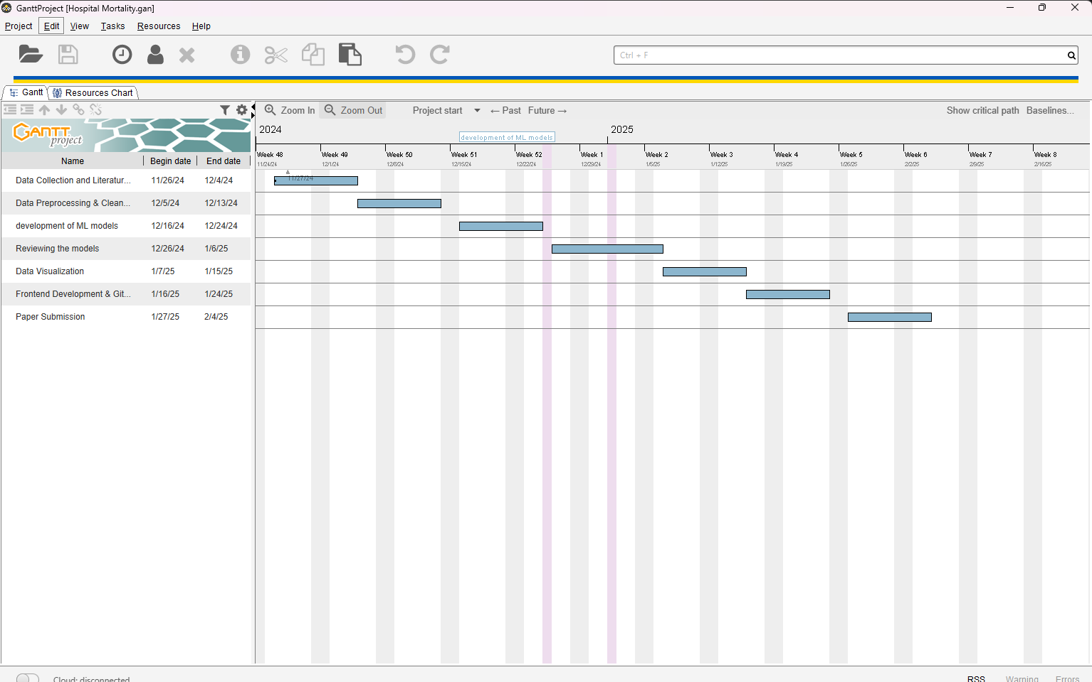
Gantt Chart

Slide 11
References
Faraoni, D., Dinardo, J. A., & Goobie, S. M. (2016). Relationship between preoperative anemia and in-hospital mortality in children undergoing noncardiac surgery. Anesthesia and Analgesia, 123(6), 1582–1587. https://doi.org/10.1213/ANE.0000000000001499
Kassahun, W. T., Babel, J., & Mehdorn, M. (2024). The impact of chronic obstructive pulmonary disease on surgical outcomes after surgery for an acute abdominal diagnosis. European Journal of Trauma and Emergency Surgery, 50(3), 799–808. https://doi.org/10.1007/s00068-023-02399-2
Kempny, A., Dimopoulos, K., Uebing, A., Diller, G. P., Rosendahl, U., Belitsis, G., Gatzoulis, M. A., & Wort, S. J. (2017). Outcome of cardiac surgery in patients with congenital heart disease in England between 1997 and 2015. PLoS ONE, 12(6). https://doi.org/10.1371/journal.pone.0178963
Pearse, R. M., Clavien, P. A., Demartines, N., Fleisher, L. A., Grocott, M., Haddow, J., Holt, P., Moreno, R., Pritchard, N., Rhodes, A., Wilson, M., Ferguson, M., Macmahon, M., Shulman, M., Cherian, R., Currow, H., Kanathiban, K., Gillespie, D., Pathmanathan, E., … Hubner, M. (2016). Global patient outcomes after elective surgery: Prospective cohort study in 27 low-, middle- and high-income countries. British Journal of Anaesthesia, 117(5), 601–609. https://doi.org/10.1093/bja/aew316
Chaudery, H., Macdonald, N., Ahmad, T., Chandra, S., Tantri, A., Sivasakthi, V., Mansor, M., Matos, R., Pearse, R. M., & Prowle, J. R. (2019). Acute kidney injury and risk of death after elective surgery: Prospective analysis of data from an international cohort study. Anesthesia and Analgesia, 128(5), 1022–1029. https://doi.org/10.1213/ANE.0000000000003923
Carrier, M., Pineault, R., Tremblay, N., & Conrad Pelletier, L. (1993). CLINICAL AND COMMUNITY STUDIES 0 ETUDES CLINIQUES ET COMMUNAUTAIRES Outcome of rationing access to open-heart surgery: effect of the wait for elective surgery on patient outcome. In CAN MED ASSOC J (Vol. 149, Issue 8).
Hutchinson, J. P., Fogarty, A. W., McKeever, T. M., & Hubbard, R. B. (2016). In-Hospital Mortality after Surgical Lung Biopsy for Interstitial Lung Disease in the United States. 2000 to 2011. American Journal of Respiratory and Critical Care Medicine, 193(10), 1161–1167. https://doi.org/10.1164/rccm.201508-1632OC

Slide 12
Bustamante, A., Giralt, D., García-Berrocoso, T., Rubiera, M., Álvarez-Sabín, J., Molina, C., Serena, J., & Montaner, J. (2017). The impact of post-stroke complications on in-hospital mortality depends on stroke severity. European Stroke Journal, 2(1), 54–63. https://doi.org/10.1177/2396987316681872
Castro-Dominguez, Y. S., Wang, Y., Minges, K. E., McNamara, R. L., Spertus, J. A., Dehmer, G. J., Messenger, J. C., Lavin, K., Anderson, C., Blankinship, K., Mercado, N., Clary, J. M., Osborne, A. D., Curtis, J. P., & Cavender, M. A. (2021). Predicting In-Hospital Mortality in Patients Undergoing Percutaneous Coronary Intervention. Journal of the American College of Cardiology, 78(3), 216–229. https://doi.org/10.1016/j.jacc.2021.04.067
Edwards, F. H., Cohen, D. J., O’Brien, S. M., Peterson, E. D., Mack, M. J., Shahian, D. M., Grover, F. L., Tuzcu, E. M., Thourani, V. H., Carroll, J., Brennan, J. M., Brindis, R. G., Rumsfeld, J., & Holmes, D. R. (2016). Development and validation of a risk prediction model for in-hospital mortality after transcatheter aortic valve replacement. JAMA Cardiology, 1(1), 46–52. https://doi.org/10.1001/jamacardio.2015.0326
Kaerslund Hansen, M., Gammelager, H., Majlund Mikkelsen, M., Hjortdal, V. E., Layton, J. B., Johnsen, S. P., & Christiansen, C. F. (2013). Post-operative acute kidney injury and five-year risk of death, myocardial infarction, and stroke among elective cardiac surgical patients: a cohort study. http://ccforum.com/content/17/6/R292
McAllister, D. A., Wild, S. H., MacLay, J. D., Robson, A., Newby, D. E., MacNee, W., Innes, J. A., Zamvar, V., & Mills, N. L. (2013). Forced Expiratory Volume in One Second Predicts Length of Stay and In-Hospital Mortality in Patients Undergoing Cardiac Surgery: A Retrospective Cohort Study. PLoS ONE, 8(5). https://doi.org/10.1371/journal.pone.0064565
Miyake, K., Iwagami, M., Ohtake, T., Moriya, H., Kume, N., Murata, T., Nishida, T., Mochida, Y., Isogai, N., Ishioka, K., Shimoyama, R., Hidaka, S., Kashiwagi, H., Kawachi, J., Ogino, H., & Kobayashi, S. (2020). Association of pre-operative chronic kidney disease and acute kidney injury with in-hospital outcomes of emergency colorectal surgery: A cohort study. World Journal of Emergency Surgery, 15(1). https://doi.org/10.1186/s13017-020-00303-6
Ruge, H., Deutsch, M. A., Erlebach, M., Burri, M., Bleiziffer, S., & Lange, R. (2020). TAVR in Patients on Hemodialysis: Outcome of A High-Risk Patient Group. Heart Surgery Forum, 23(5), E611–E616. https://doi.org/10.1532/hsf.3129

Slide 13
Cabrera, A., Bouterse, A., Nelson, M., Dietrich, C., Razzouk, J., Oyoyo, U., Bono, C. M., & Danisa, O. (2024). Prediction of In-Hospital Mortality Following Vertebral Fracture Fixation in Patients With Ankylosing Spondylitis or Diffuse Idiopathic Skeletal Hyperostosis: Machine Learning Analysis. International Journal of Spine Surgery, 18(1), 62–68. https://doi.org/10.14444/8567
Fillinger, M. P., Surgenor, S. D., Hartman, G. S., Clark, C., Dodds, T. M., Rassias, A. J., Paganelli, W. C., Marshall, P., Johnson, D., Kelly, D., Galatis, D., Olmstead, E. M., Ross, C. S., & O, G. T. (n.d.). The Association Between Heart Rate and In-Hospital Mortality After Coronary Artery Bypass Graft Surgery. https://doi.org/10.1213/01.ANE.0000034720.36481.21
Finlayson, E. (2000). Operative mortality with elective surgery in older adults. https://www.researchgate.net/publication/11820969
Lindenauer, P. K., Pekow, P., Wang, K., Gutierrez, B., & Benjamin, E. M. (n.d.). Lipid-Lowering Therapy and In-Hospital Mortality Following Major Noncardiac Surgery. www.jama.com
Smilowitz, N. R., Banco, D., Katz, S. D., Beckman, J. A., & Berger, J. S. (2021). Association between heart failure and perioperative outcomes in patients undergoing non-cardiac surgery. European Heart Journal - Quality of Care and Clinical Outcomes, 7(1), 68–75. https://doi.org/10.1093/ehjqcco/qcz066
Stahlschmidt, A., Novelo, B., Freitas, L. A., Passos, S. C., Dussán-Sarria, J. A., Félix, E. A., Gamermann, P. W., Caumo, W., & Stefani, L. P. C. (2018). Predictors of in-hospital mortality in patients undergoing elective surgery in a university hospital: a prospective cohort. Brazilian Journal of Anesthesiology (English Edition), 68(5), 492–498. https://doi.org/10.1016/j.bjane.2018.04.009
Wan, Y. I., Patel, A., Achary, C., Hewson, R., Phull, M., & Pearse, R. M. (2021). Postoperative infection and mortality following elective surgery in the International Surgical Outcomes Study (ISOS). British Journal of Surgery, 108(2), 220–227. https://doi.org/10.1093/bjs/znaa075

Slide 14
Machine Learning (ML) Implementation
Objective:
Predict facility performance scores and recommend the best facilities.
Model Details:
Model Input Features:
Location details (ZIP Code, City, State, County/Parish).
Measure-specific attributes (Measure ID, Measure Name).
Facility attributes (Facility Name, Facility ID).
Historical data (Start Date, End Date, Score).
Target Variable:
Score: Predict the Score for healthcare facilities based on location and other attributes.
Alternatively, classify facilities into categories (e.g., "Better," "Worse," or "No Different" compared to national averages).
ML Techniques:
Regression Models:
Use models like Random Forest Regressor or XGBoost to predict numerical scores.
Classification Models:
Use Logistic Regression, Decision Trees, or Gradient Boosting to classify facilities based on the "Compared to National" column.
Location-Based Filtering:
Use geospatial distance calculations (e.g., Haversine formula) to filter facilities within the patient’s proximity.

